Slide 1
Family Perspective on Transition Services
Christine M Grosso, MS
Health Administration Fellow: Leadership Education in Neurodevelopmental and Related Disabilities
Research support from: DHHS, HRSA, Maternal and Child Health Bureau (GCDRC0217D)
Notes:
Today I will be presenting on Transition Services for children who experience disability.

Slide 2
Transition Services: Introduction
Health Care Transition (HCT) is defined as the purposeful and planned process of moving from pediatric to adult health care (Blum, 2002)
Children and Youth with Special Health Care Needs (CYSHCN) have a variety of complex heath care needs and, as a result, are at an increased risk of poverty, abuse, unemployment, and limited social experiences (Virginia Dept of Heath, 2009)
Successful HCT is necessary to mitigate these risk factors and optimize their health potential (Virginia Dept of Heath, 2009)
Notes:
Health Care Transition is defined as the purposeful and planned process of moving from pediatric to adult health care
The Virginia Dept of Heath identifies that Children with Special Health Care Needs have a variety of complex heath care needs and, as a result, are at an increased risk of poverty, abuse, unemployment, and limited social experiences
That being said, successful Health Care Transition is necessary in order to mitigate these risk factors and optimize each child’s health potential

Slide 3
Current Status of HCT
Approximately 750,000 CYSHCN make the transition from pediatric care to adult care every year (Agency for Healthcare Research and Quality, 2014)
Yet, a recent national survey found that only 21% had a successful transition to adult care (Oswald et al, 2013)
The majority of providers did not write clear transition plans, direct families to resources that facilitate transition, or identify providers who were comfortable caring for transition-aged youth who experience disability (MCHB, 2006)
Notes:
In 2014 the Agency for Healthcare Research and Quality found that [read slide]
And despite this, [read slide]
The Maternal and Child Health Bureau found that unsuccessful transition could be a result of the majority of providers not writing clear transition plans, not directing families to resources that facilitate transition, and/or not identifying providers who were comfortable caring for transition-aged youth who experienced disability

Slide 4
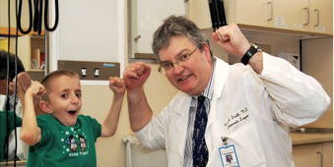
American Academy of Pediatrics
“…we are acknowledging that physicians have an important role in facilitating transitions to adulthood and to adult health care for young people who are least likely to do it successfully on their own.”
Notes:
In order to address the rising concern of healthcare transition services, the American Academy of Pediatrics did state that they acknowledge that physicians have an important role in facilitating transitions for those who are least likely to do it successfully on their own. And because of this, have issued a policy statement with the goals to:
understand the rationale for transition from child-oriented to adult-oriented health care;
have the knowledge and skills to facilitate that process; and
know if, how, and when transfer of care is indicated.
It is the first step for the medical profession to maximize lifelong functioning and potential through the provision of uninterrupted health care services as the individual moves from adolescence to adulthood.

Slide 5
Needs Assessment Survey
Conduct transition needs assessment survey in four clinics
Purpose:
Identify current efforts to serve transition age youth
Identify barriers to providing transition services
Determine the most effective way to partner with our clinics
Results:
Providers felt ill-equipped to provide families with adequate transition supports;
Providers expressed that they would benefit from resources and training surrounding transition;
Providers responded positively to adhering to best practice method alerts.
Notes:
Because of the apparent national need for improved transition services, in 2011 OHSU established a Transition Committee.
Their main goal was to conduct a transition needs assessment within four clinics:
Spina Bifida; LEND; Neurodevelopment; and Down Syndrome
They surveyed providers with three major purposes: 1) they wanted to identify what was currently being done to serve transition age youth who were attending our clinics; 2) to identify perceived barriers to providing appropriate transition services; and 3) to determine how we can improve transition services and how can we be helpful to providers in delivering those services.
The results of the survey indicated that [read slide]

Slide 6
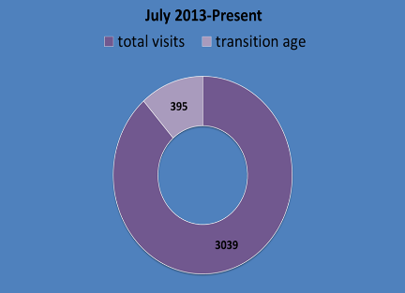
Follow-up to Needs Assessment Survey
Identify transition age clients
Write a clear transition policy
Build OHSU/Statewide network by increasing collaborative efforts
Develop training resources and best practice methods for clinicians and families
12% were transition age
(ages: 12-26)
Notes:
Following the results of this survey, the transition committee responded by these four measures:
1. To identify the percentage of transition age clients: And of the 3,039 visits between July 2013 and January 2014, 12 % (or 395) were youth in the transition age range of 12 – 26.
2. To create a policy that states that transition services will include provision of resources, dialogue with professionals, and transition-based assessment and planning.
3. To build community network capacity by learning about transition statewide programs and practices.
And 4. to develop a transition resource guide to give to families and “best practice” alerts for providers.

Slide 7
Transition Resource Guide
Youth Friendly
Parent Friendly
Clinician Friendly
Notes:
This is the resources guide that was created, which offers:
Suggestions on self-empowerment
Taking control of your healthcare
Guidance for parents on ways to interact with their children and what to ask their providers
Contact information for state and local agencies

Slide 8
Best Practice Alert (BPA) for Clinicians
BPA alerts were implemented in four clinics
Target group: youth aged 12-26
Method: a transition guide was given and discussed during an office visit
Accountability: EPIC, which is an Electronic Medical Record (EMR) system used at OHSU, directs the users to a Document Flow-sheet to record data regarding the transition discussion
Notes:
The BPA for providers was implemented in the same four clinics:
The BPA appears for any scheduled face-to-face visits for patients between the ages of 12-26, and at the moment it is collecting data on:
If the Transition Guide was provided;
If it was discussed; and
If the provider felt better equipped to discuss transition with families
This is monitored through EPIC, which is an Electronic Medical Record (EMR) system used at OHSU

Slide 9
Current Research: Family Perspective
Question:
Is the current adolescent transition model effective?
What are families’ experiences with the current model?
Method:
Quality Assurance/Quality Improvement Survey to assess patient satisfaction
Phone interview
Participants: 16 families (four from each clinic), age range 12-26
Interviews were transcribed and common themes identified
Notes:
My current role within the Transition Committee and in the LEND program is to determine if the current model is effective and if families feel ready to manage transition.
This specific study is a Quality Assurance/Quality Improvement project to evaluate the effectiveness of the current transition model at the four pilot clinics from a family perspective and assess patient satisfaction.
Participants were recruited randomly from parents of transition aged youth who had a visit to one of the four clinics between the dates of January 1st, 2014 to present.
Data was collected via a short phone survey following the appointment; the first 16 to agree to be interviewed were selected. The interviews followed a set of up to 10 predetermined questions that identified the family’s experience of engaging in a discussion of transition with a provider during their regular appointment.
Interviews were recorded and transcribed, and common themes were identified that revealed opportunities for quality improvement.

Slide 10
Quality Improvement Survey
How have you used the transition guide?
Was it helpful, and how could it have been more helpful?
Did the provider talk with you about transitioning to adulthood during the appointment?
What types of transition topics are important to you and your family? Did you have the opportunity to talk about them?
Did you know who to talk to after the visit if you had questions about transition?
At what age was transition first discussed?
Would you say the discussion of transition was overall helpful?
Notes:
These are sample questions from the survey I created and we will go over the majority of them when I discuss the results.
(Email handout to MLC for printing)

Slide 11
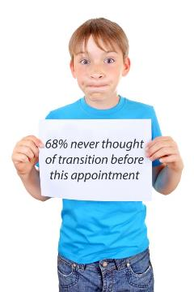
Results of the Survey
Notes:
From the interviews I conducted, I found that:
68% of the families said they had not thought of transition before this appointment.
75% of the families remembered receiving the guide
And of these families,
100% of them took it home
90% said it was helpful, and
67% reviewed it again after the appointment

Slide 12
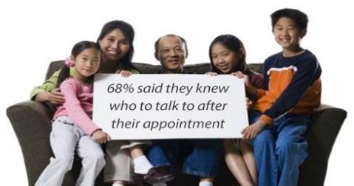
Results of the Survey Continued
Notes:
68% of them said they knew who to talk to in order to access supports because of the information they received from their appointment
56% of the families rated their experience as excellent, 25% as very good, and 18% as good
And all participants either agreed or strongly agree that the discussion of transition was helpful and needed.

Slide 13
Common Themes
Most of the parents:
Viewed transition as a distant issue
Felt overwhelmed with their child’s present needs that they were unable to focus on future transition needs
Important topics to parents included:
independence, socialization, emotional well-being, access to services, and finding an adult provider who understood special needs
Most families did not think about transition prior to this appointment, but for those who did, they felt like they had inadequate resources and supports to be successful
Most parents agreed that these topics should be discussed before they actually happen
Notes:
I found that the majority of parents felt overwhelmed with transition and chose to deal with it when they were faced with the issue directly.
And another upsetting theme was that of the parents who were ready to act on transition prior to the appointment, most of them felt like they had inadequate resources and supports. As one parent stated, "I have been thinking about it since my daughter was 14, but no one would help me."

Slide 14
Reflections from Parents
“Every time I mentioned transition to the school or case coordinator they would tell me to wait till she was older; they said I was getting ahead of myself.“
“I feel like once she graduates she is going to lose all supports and I don't know what to do."
"It seems like its 100 years in the future, it was a harsh reality to even consider it… I feel lost when it comes to all this."
"… I thought I would have more time to deal with these things later, but here we are now... I think it is really important to talk about these topics before they actually happen."
"I enjoyed the appointment tremendously. We had great resources to take back to the IEP team and now we have a good outlook in regards to her transition program.”
Notes:
From the conversations I had with parents during these interviews, I felt these first four quotes were very impactful and truly captured the struggle that parents face when dealing with these issues; and this last quote I believe displays how important appropriate transition services are and the positive impact they can have.

Slide 15
2015 Transition Fair
May 30th, 2015
This free event emphasizes a holistic approach to adolescent transition for young people (ages 12-26) who experience disability
The event will feature community transition resources as well as a series of presentations for individuals, families, and providers
Notes:
As a result of the feedback from families and the positive response of providers wanting more information, myself and another trainee have begun organizing and coordinated a transition resource fair that will also include a series of presentations.
This free event will emphasize a holistic approach to transition for young people who experience disability.
It will take place at the Collaborative Life Sciences Building, which houses three universities including OHSU and will offer free accessible parking, free lunch provided by a local business, and a Transition Resource Guide.
Also, attendees who choose to participate in our passport game will be entered into a raffle for fun prizes.

Slide 16
Passport to a Healthy Future
May 30th, 2015
This event will provide:
Education on important topics related to transitioning into adulthood
Access to community resources
Connections with service providers and community programs for transitioning youth
Information on health and wellness resources for youth and families
Topics:
Healthcare, "Transition 101"
Employment; Navigating Vocational Rehabilitation and DD Services
Special Education; Self-Empowerment
“Keeping it Real with your Patients; with Teens; with your Doctor”
Guardianship and Insurance
Special Needs Trust
Notes:
We have decided to call it Passport to a Healthy Future ☺
This event will provide:
Education on a variety of topics related to transition;
Access to community resources;
Connections with service providers and community programs; and
Information on health and wellness resources for youth and families
The seminar topics will include:
Healthcare; Guardianship and Insurance; Special Needs Trust; Employment (because navigating Voc Rehab and DD Services can be very difficult to manage); Special Education; Self-Empowerment; and Sexual Health
Each speaker will be an expert in their field. For example we will have a physician from the Spina Bifida clinic presenting on health care; a lawyer from Disability Rights Oregon presenting on Guardianship and the Trust; a case coordinator from VR will be speaking about employment; a representative from Planned Parenthood speaking about sexual health; and FACT Oregon will be addressing Special Education.

Slide 17
On the Horizon
Transition Clinic for all transition age clients: to improve the healthcare outcomes for adolescents who experience disabilities
Interdisciplinary
Mentoring
Care Coordination
Assessment
Collaboration
Outcomes Focused
Notes:
Our long term goal is to develop a Transition Clinic at OHSU Portland: The central purpose of the clinic would be to improve the healthcare outcomes for adolescents with disabilities by incorporating early assessment and transition planning through an interdisciplinary clinic. This will not be a diagnostic assessment clinic, but rather a transition assessment clinic, which will include: Medical, Adaptive, and Educational assessments
Define Interdisciplinary

Slide 18
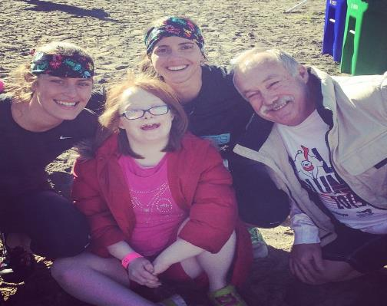
Thank you
Questions?
grossoc@ohsu.edu
2015 Special Olympics Polar Plunge!
Notes:
This was taken a couple months ago at the 2015 Polar Plunge event; this year it was dedicated to the Special Olympics.
This is my best friend Trozell, her uncle, and her 21 year old cousin, Shelby who swims for the Special Olympics.
And I will tell you... The water. Was. Cold!! And especially cold for me because I am from Florida.
Thank you ☺

Slide 19
References
Agency for Healthcare Research and Quality (2014). Effective Health Care Program: Transition Care for Children with Special Health Needs. http://www.effectivehealthcare.ahrq.gov/ehc/products/546/1920/children-special-needs-transition-report-140617.pdf
American Academy of Pediatrics (2002). A consensus statement on health care transitions for young adults with special health care needs. Pediatrics, 110(6), 1304-6. http://www.ncbi.nlm.nih.gov/pubmed/12456949
Blum, R. W. (2002). Introduction. Improving transition for adolescents with special health care needs from pediatric to adult-centered health care. Pediatrics, 110(6),1301–3. http://www.ncbi.nlm.nih.gov/pubmed/12456948

Slide 20
References Continued
Maternal Child and Health Bureau (2006). Youth with special health care needs receive the services necessary to make transitions to all aspects of adult life, including adult health care, work, and independence. http://mchb.hrsa.gov/cshcn05/mco/06yrts.htm
Oswald, et al (2013). Youth with special health care needs: Transition to adult health care services. Maternal Child Health, 17(10), 1744-52. doi: 10.1007/s10995-012-1192-7.
Virginia Dept of Heath (2009). Children with Special Health Care Needs Program: “Community Partners for Children and Youth Summit.” https://www.vdh.virginia.gov/ofhs/childandfamily/childhealth/cshcn/
documents/2012/pdf/home/Briefs.Executive%20Summary.pdf

