Slide 1
Racial Disparity in Correlates of Late Preterm Births: A Population-Based Study
Shailja Jakhar, Christine Williams, Louis Flick, Jen Jen Chang, Qian Min, Jing Wang
Abstract Presentations, Epidemiology (Group 3)
9:00am - 10:00 am, Friday 4/24/2015, JH Quinn Room
Making Lifelong Connections 2015:
Leadership, Networking, and Professional Development
fifth Annual Meeting, San Antonio, TX (April 23-24, 2015)

Slide 2
Introduction
Full Term Birth: born during or after 37 weeks of gestation
Preterm Birth: born before 37 weeks of gestation
Negative health outcomes from preterm birth
Two types of preterm birth
Spontaneous
Nonspontaneous (medically-indicated)
Late Preterm Birth (LPTB): born 34 0/7 weeks to 36 6/7 weeks of gestation
70% of preterm births are LPTB

Slide 3
Dataset
2012 US birth certificate data
Exclusions
non-US citizen mother
major birth defects
plural births
<= 33 weeks gestation
Mother’s older than 45
Final sample size: 2.7 million

Slide 4
Outcomes
Spontaneous late preterm birth: included all vaginal births without induction of labor or maternal medical complications.
Medically indicated late preterm birth: any birth with any of these conditions: induction of labor, cesarean, or maternal medical complications, including diabetes, gestational diabetes, hypertension, gestational hypertension, or eclampsia.

Slide 5
Methods & Analysis
Descriptive and bivariate analysis
t-test for continuous variable
Chi square test for categorical variables
Binary multivariable logistic regression to estimate odds ratio and 95% confidence intervals
Stratified analysis by maternal race/ethnicity
Risk factors
Mother’s marital status
Mother’s age
Number of prenatal visits
Mother’s education
Infant sex
Maternal health conditions
Smoking during pregnancy
WIC
Maternal Infection
Previous preterm birth
Infertility treatment
Interval between previous live birth
Weight gain recommendations

Slide 6
LPTB Prevalence by Race

Slide 7
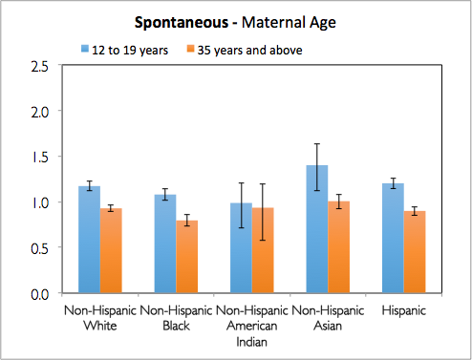
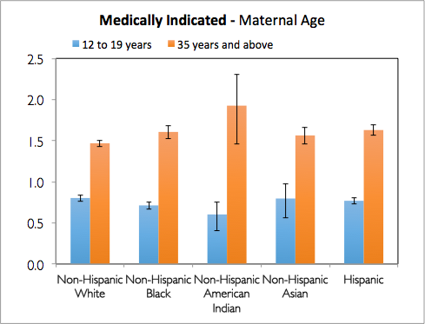
Maternal Age
*
*
*
*
*
*
*
*
*
*
*
*
*
*
*
*
Reference: 20 to 34 years
*
indicates significant values

Slide 8
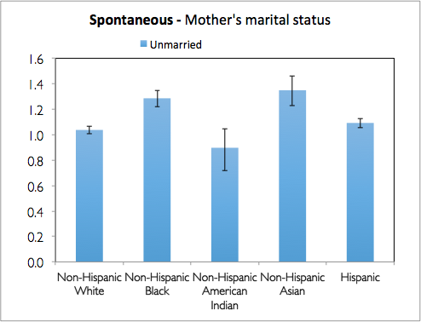
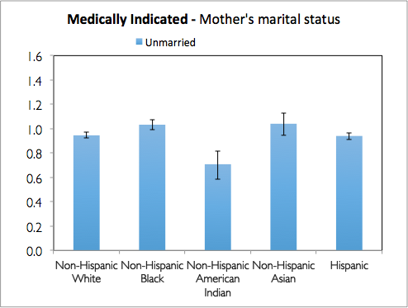
Mother’s Marital Status
*
*
*
*
*
*
*
Reference: Married
*
indicates significant values

Slide 9
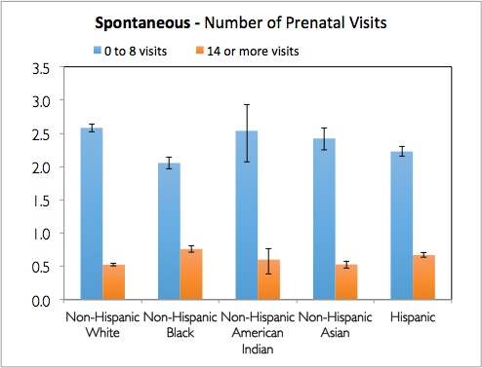
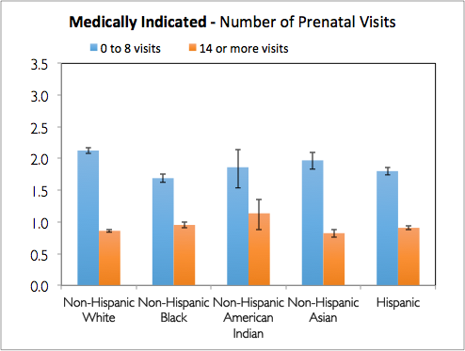
Number of Prenatal Visits
*
*
*
*
*
*
*
*
*
*
*
*
*
*
*
*
*
*
*
Reference: 9 to 13 visits
*
indicates significant values

Slide 10
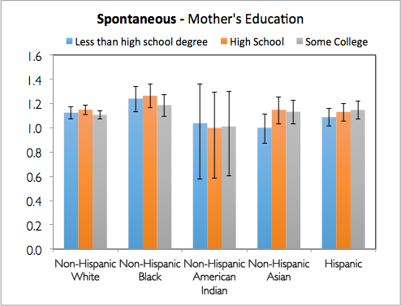
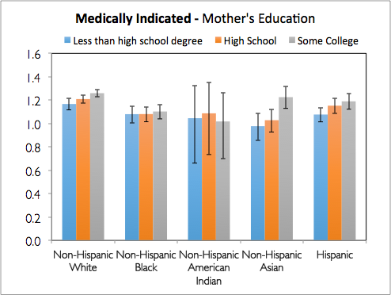
Mother’s Education
*
*
*
*
*
*
*
*
*
*
*
*
*
*
*
*
*
*
*
*
*
Reference: College or above
*
indicates significant values

Slide 11
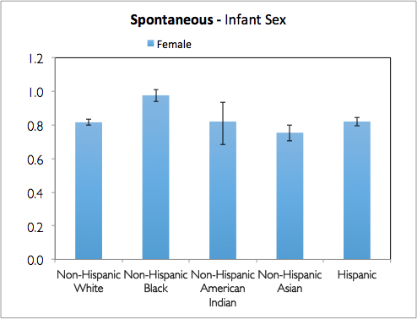
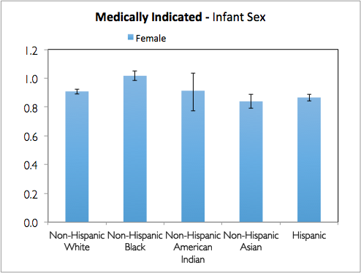
Infant Sex
*
*
*
*
*
*
*
Reference: Male
*
indicates significant values

Slide 12
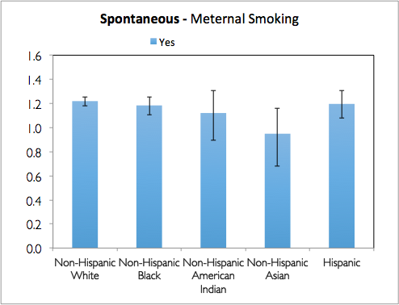
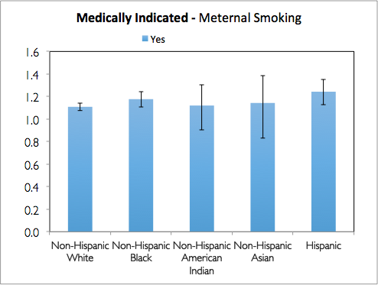
Maternal Smoking
Spontaneous - Maternal Smoking
Medically Indicated - Maternal Smoking
*
*
*
*
*
*
Reference: No
*
indicates significant values

Slide 13
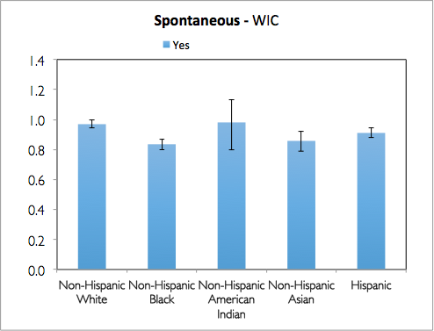
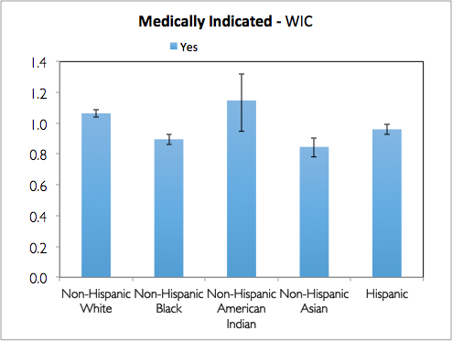
WIC
*
*
*
*
*
*
*
*
Reference: No
*
indicates significant values

Slide 14
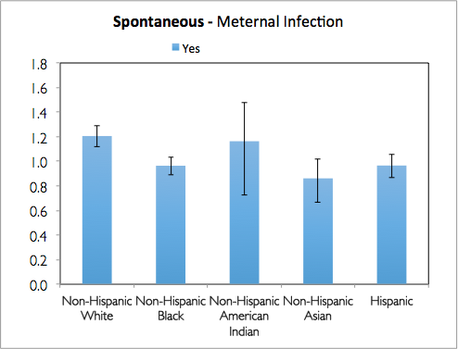
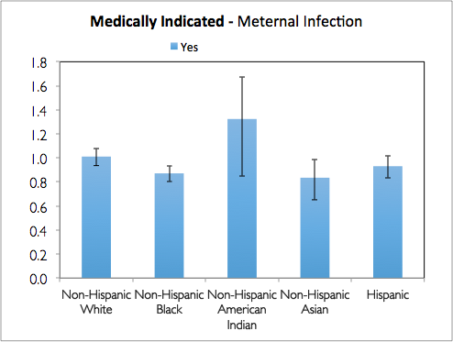
Maternal Infection
Spontaneous - Maternal Infection
Medically Indicated - Maternal Infection
*
*
Reference: No
*
indicates significant values

Slide 15
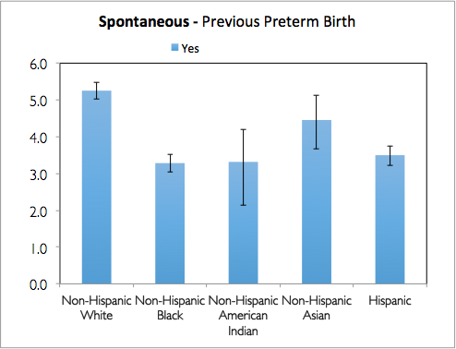
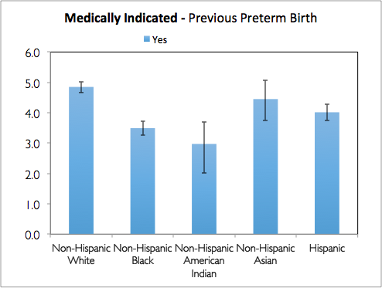
Previous Preterm Birth
*
*
*
*
*
*
*
*
*
*
Reference: No
*
indicates significant values

Slide 16
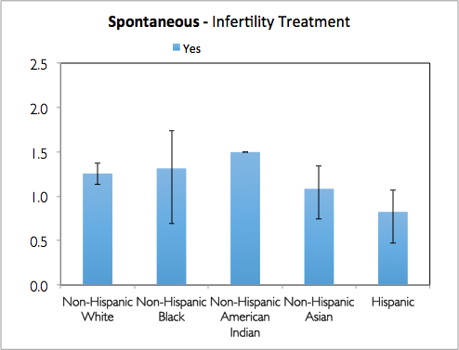
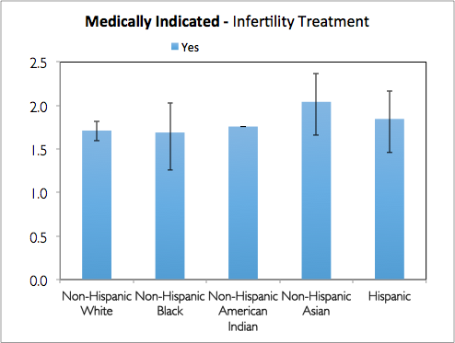
Infertility Treatment
*
*
*
*
*
Reference: No
*
indicates significant values

Slide 17
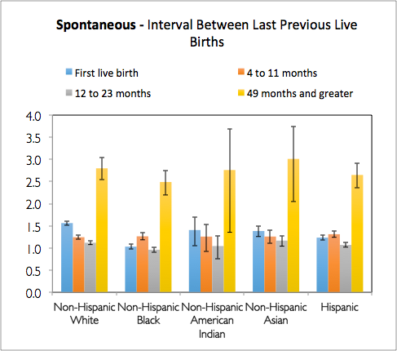
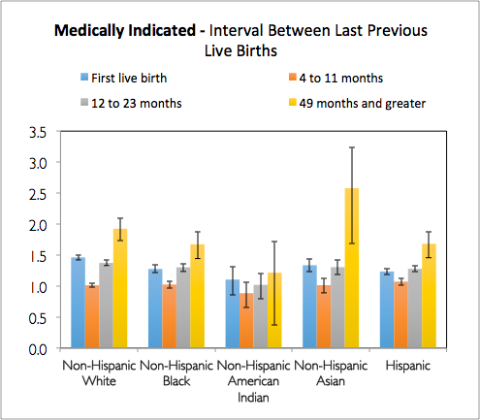
Interval Between Previous Live Births
*
*
*
*
*
*
*
*
*
*
*
*
*
*
*
*
*
*
*
*
*
*
*
*
*
*
*
Reference: 24 to 48 months
*
indicates significant values

Slide 18
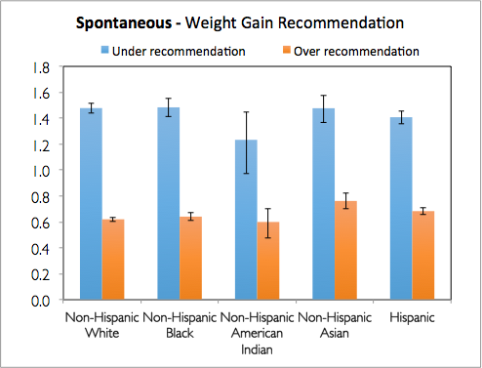
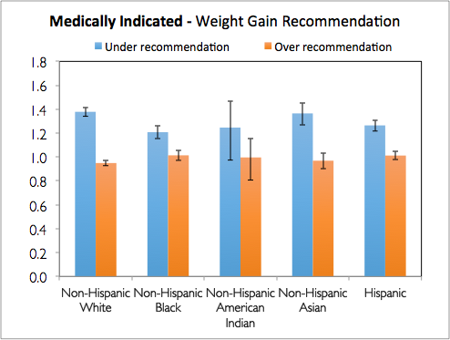
Weight Gain Recommendations
*
*
*
*
*
*
*
*
*
*
*
*
*
*
*
Reference: Recommended amount
*
indicates significant values

Slide 19
Discussion
Risk factors that increase risk for LPTB
Mother aged 35 and above
Mother’s education less than college degree
Less than 9 prenatal visits
Under recommendation weight gain
Smoking during pregnancy
Maternal medical conditions
Risk factors that decrease risk for LPTB
Greater than 13 prenatal visits
Over recommendation weight gain
Female infant
WIC

Slide 20
Strengths
Large sample size
Examination of effect modification of maternal race/ethnicity and the subtypes of LPTB on risk factors
Limitations
Small sample size for specific subgroups
Non-Hispanic American Indian
Potential for inaccurate reporting
Residual confounding
For example: no BMI information
Indirect measurement of spontaneous and non-spontaneous LPTB

Slide 21
Thanks for your attention

