Slide 1
Maintaining Your MCH Leadership Momentum
Making Lifelong Connections 2015
San Antonio, Texas

Slide 2
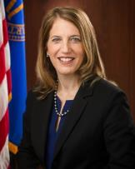
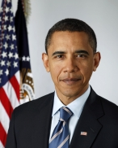
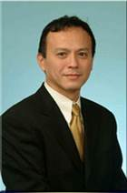
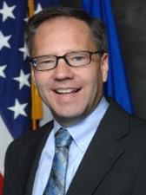
The BIG Picture
The President
Barack Obama
Secretary, HHS
Sylvia Mathews Burwell
Acting Administrator, HRSA
Jim Macrae
Associate Administrator, MCH Dr. Michael Lu
Division of MCH Workforce Development

Slide 3
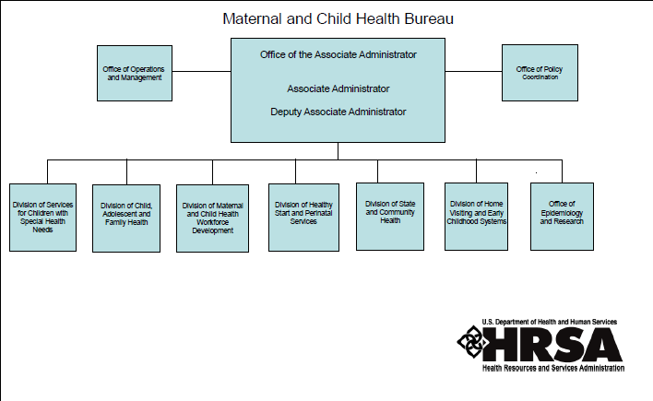
The BIG Picture

Slide 4
MCHB Welcome

Slide 5
Who are MCH Trainees?

Slide 6
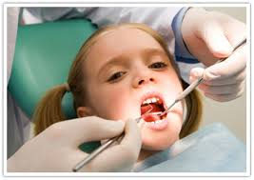
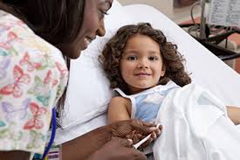
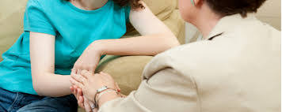
Who are MCH Trainees?

Slide 7
Who are MCH Trainees?

Slide 8
Former Trainees are Leaders
FY 2012 DGIS data

Slide 9
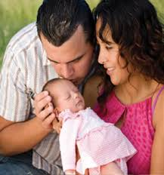
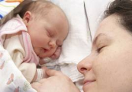
Where Are They Now?
Working in Public Health
Working with MCH Populations
Working with Underserved or Vulnerable Populations
37%
84%
74%
FY 2012 DGIS data

Slide 10
Making Lifelong Connections
Make a wordle using evaluation from across MLC Conferences

Slide 11
MCH Navigator Demo
http://www.mchnavigator.org/assessment/index.php

Slide 12
MCH Leadership Competencies
I. SELF
1. MCH Knowledge Base
2. Self-reflection
3. Ethics & Professionalism
4. Critical Thinking
II. OTHERS
5. Communication
6. Negotiation & conflict resolution
7. Cultural Competency
8. Family-Centered Care
9. Developing Others Through Mentoring & Teaching
10. Interdisciplinary Team Building
III. WIDER COMMUNITY
11. Working with Communities and Systems
12. Policy/Advocacy

Slide 13
Online Self-Assessment

Slide 14
Trainee Ambassador Group
Fostering connections between trainees, leadership development opportunities, strengthening the link between trainees and MCHB
15-month commitment
Virtual meetings
2-4 hour/month
Small honorarium

Slide 15
Trainee Ambassador Group

Slide 16
Trainee Ambassador Group
Eligibility: Current or former trainee within an MCHB training program
July 2015: Selection of applicants
August/September 2015: Kick-off activities begin
MCH Training & Research Resource Center mch-trc@altarum.org

Slide 17
Trainee Ambassador Group
Application open April 27th - May 31st
Application, resume, unofficial transcript, recommendation form

Slide 18
Trainee Resources
http://www.mchb.hrsa.gov/training/tr_resources.asp

Slide 19
Connect With Us!
MCHB Fall Internship
Sign up for the Trainee Listserv
Share your trainee story
Other ideas?
Michelle Menser Tissue
MTissue@hrsa.gov
(301) 443-6853

